Slide 1
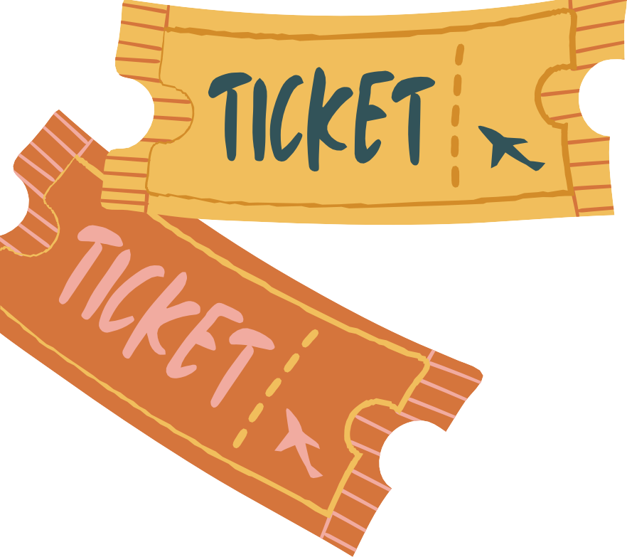
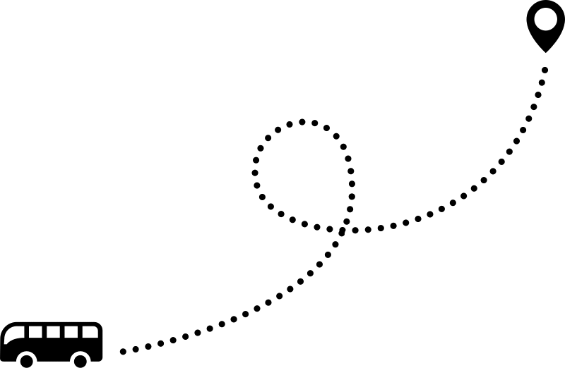
On lin e Bus
Tic k e t Boo k i n g
“YatriSafar”

Slide 2





Presented By
Name: Punit Patel Name: Nitesh Kumar Name: Randhir kr. Ray Name: Bikash Thakur
- Reg No. 211211250010
- Reg No. 211211250033
- Reg No. 211211250028
- Reg No. 211211250007

Slide 3


Introduction
Online bus ticket booking refers to a web-based platform built on Django, enabling users to seamlessly reserve, modify, and print bus tickets. This system empowers travelers to conveniently browse available routes, select desired departure times, and secure their seats with ease. Through an intuitive interface, users can not only book tickets but also cancel or reschedule their reservations effortlessly. Additionally, features like ticket printing and viewing booking history enhance user convenience.

Slide 4



Project Specification
Front End Tools
Back End Tools
Web Server
Web Browser
IDE
Hardware
Operating System
: HTML, CSS, Bootstrap, js.
: Python, Django, SQLite Database.
: Django.
: Chrome, MS Edge.
: VS code.
: 64-bit Processor, 2.30 Ghz,
4 GB RAM.
: MS Windows 7 or Higher

Slide 5



SDLC
In the project, the Spiral SDLC model is adopted for its iterative and risk-driven approach. This model enables continuous refinement and enhancement throughout the development lifecycle. By breaking down the project into smaller, manageable iterations, it allows for early detection and mitigation of potential risks. The Spiral model promotes flexibility, accommodating changes and feedback at each stage, ensuring alignment with evolving requirements and delivering a high- quality end product.

Slide 6


User Modules
01
05
User can signup and login with the valid username and password
view Booking and Print Ticket
history
04
02
View About us , Help, contact, My profile and other pages
Book Bus Ticket
03
Cancel Booking

Slide 7

Admin Modules
01
05
Admin can add/ update/ delete Bus list
Admin can also manage booking status
04
Admin can Change own Password after Login
02
Admin can view the Bus Booking of all user.
03
Admin can view all registered user

Slide 8



Screen Layout

Slide 9
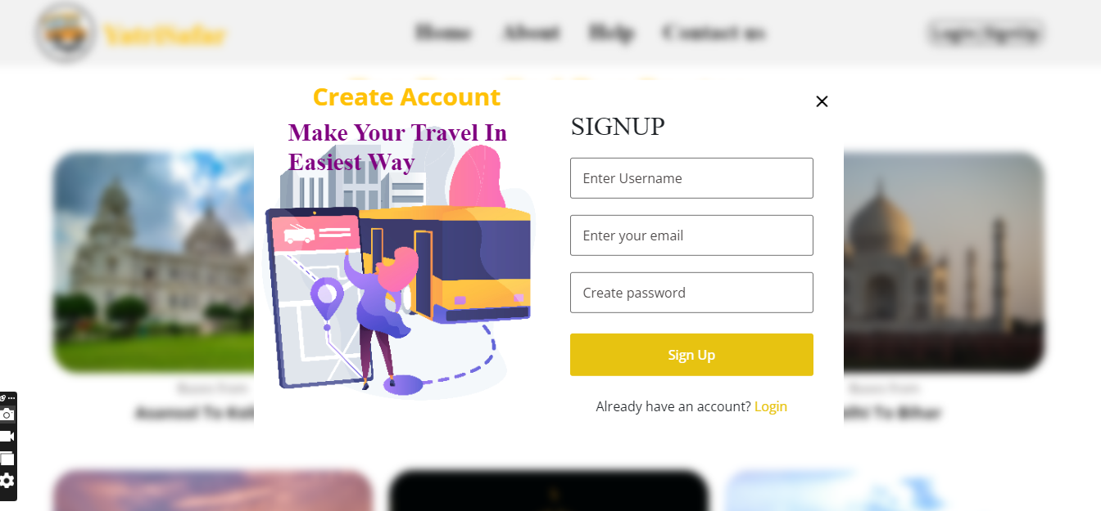
Sign Up Page

Slide 10
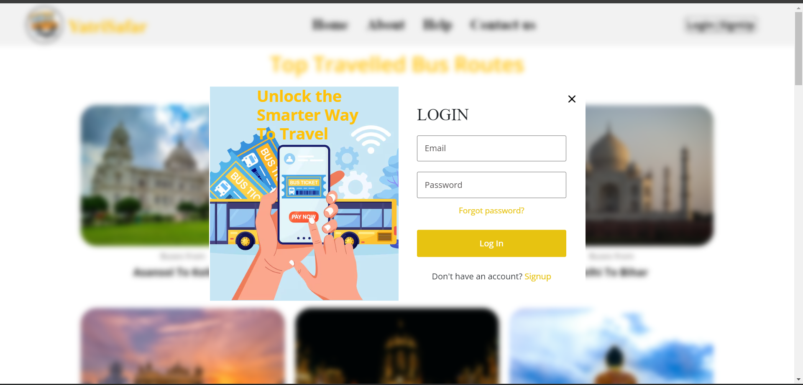
login Page

Slide 11
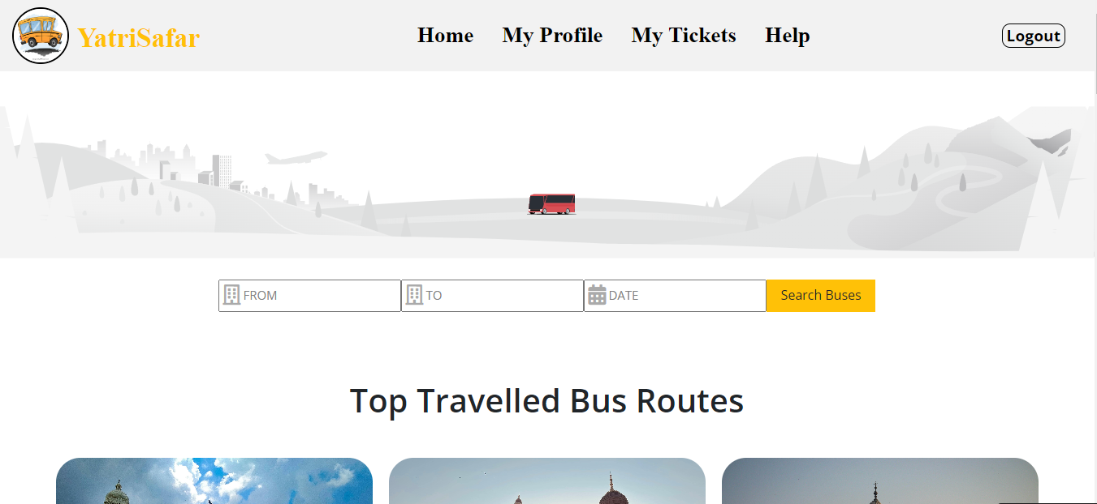
Home Page

Slide 12
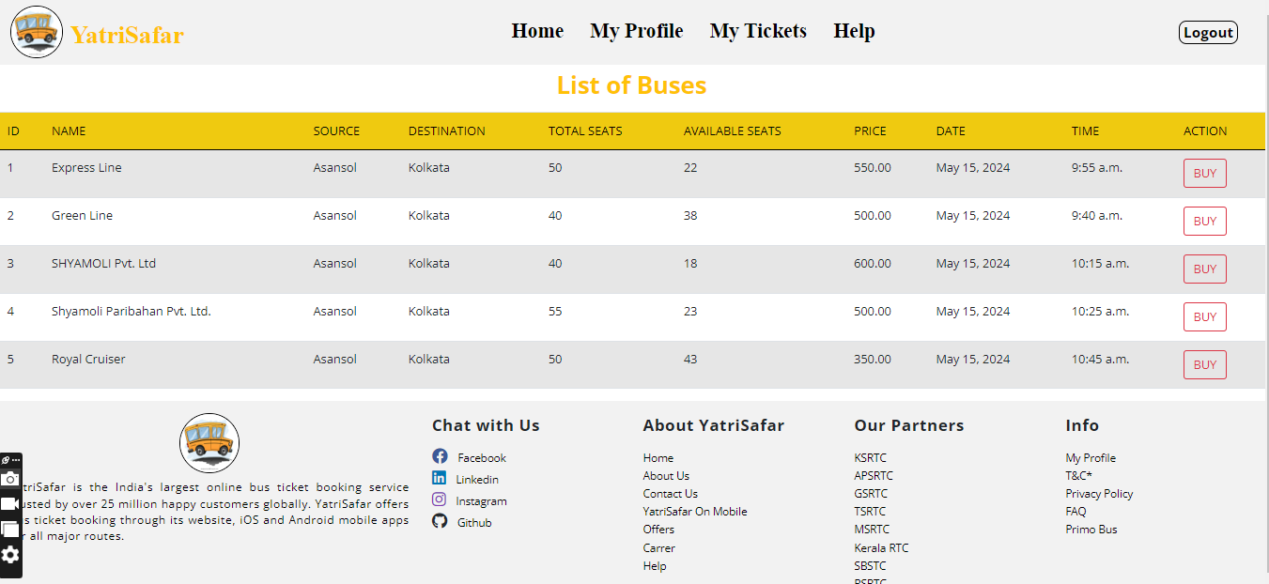
Searches Bus List

Slide 13
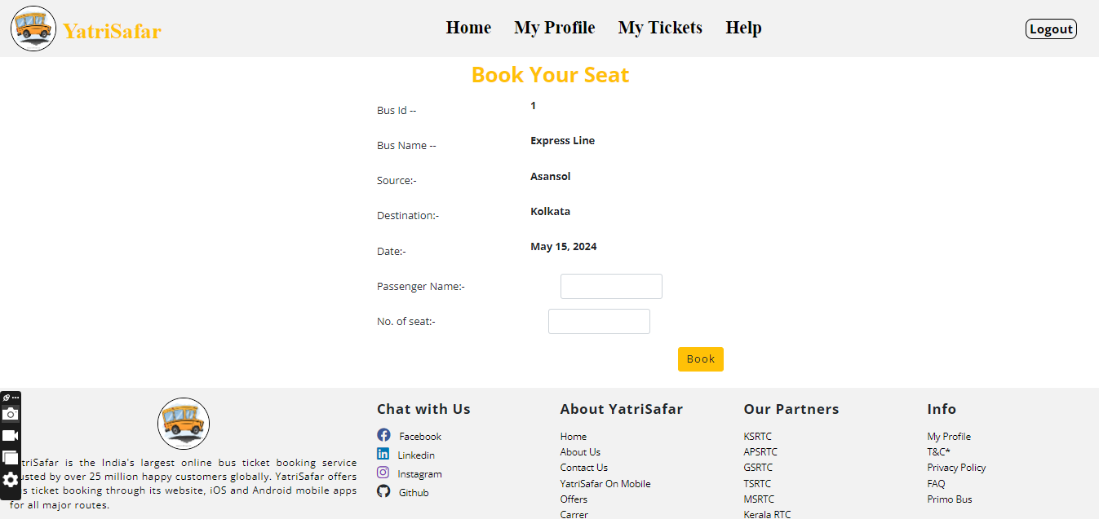
Ticket Buy Process Page

Slide 14
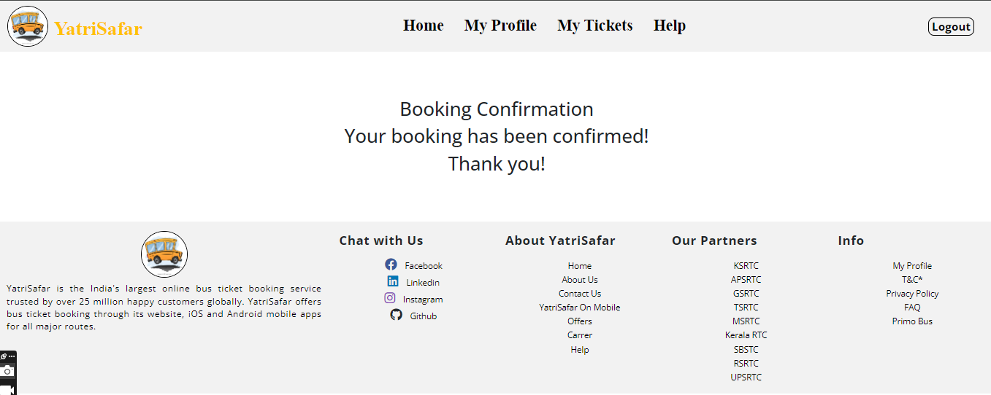
Ticket Confirmation Page

Slide 15
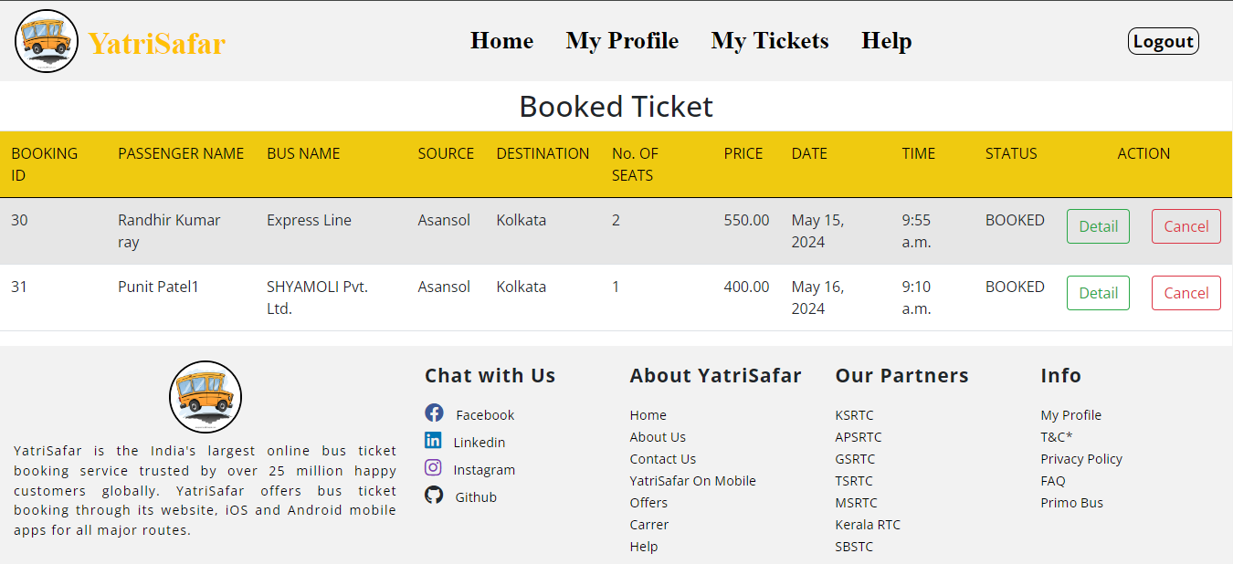
My Ticket

Slide 16
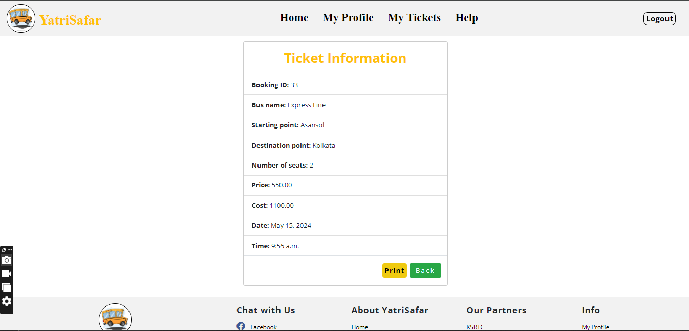
Ticket Details

Slide 17
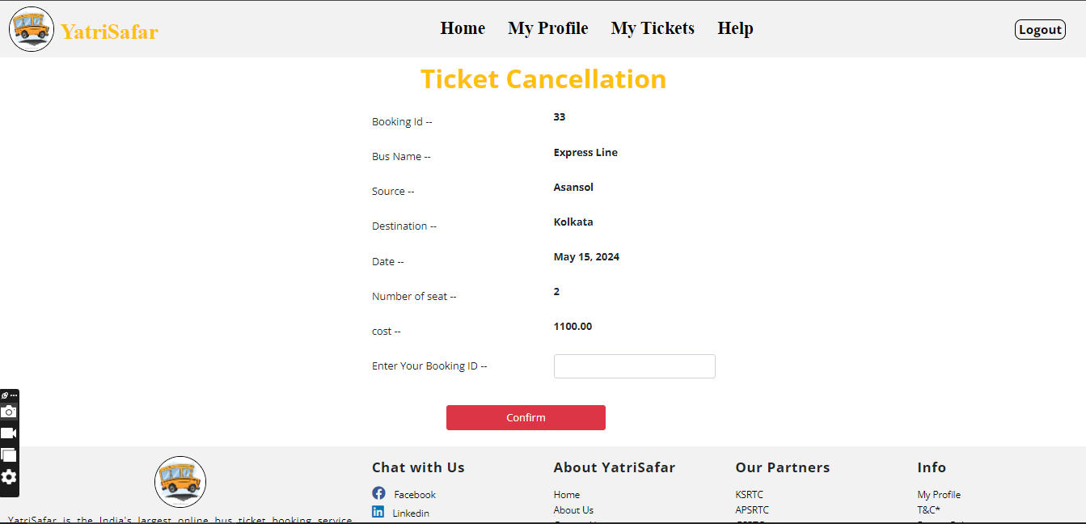
Ticket Cancelling

Slide 18
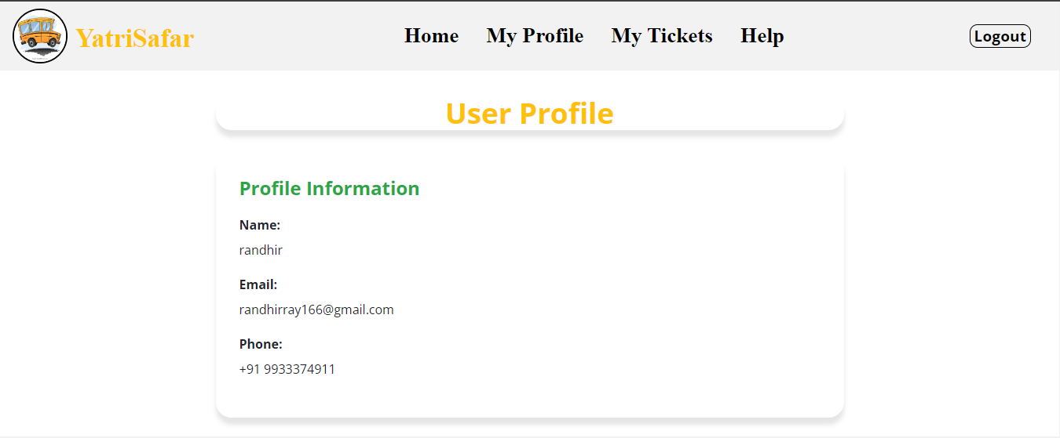
My Profile

Slide 19
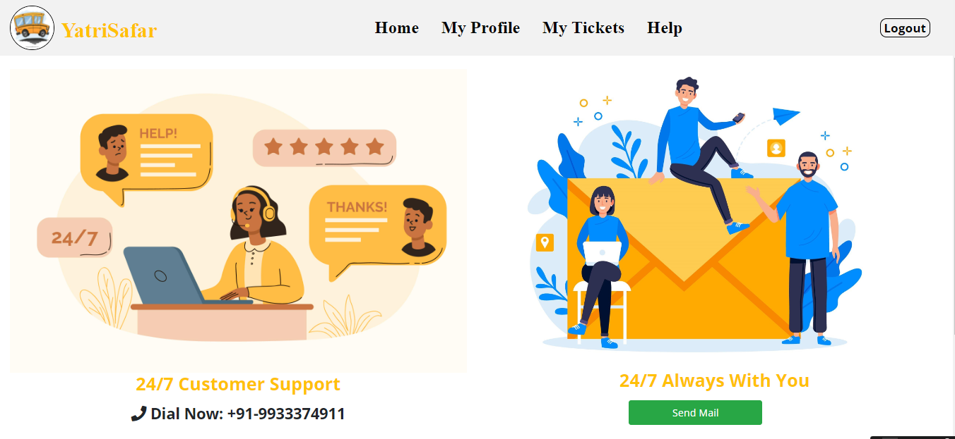
Help Page

Slide 20
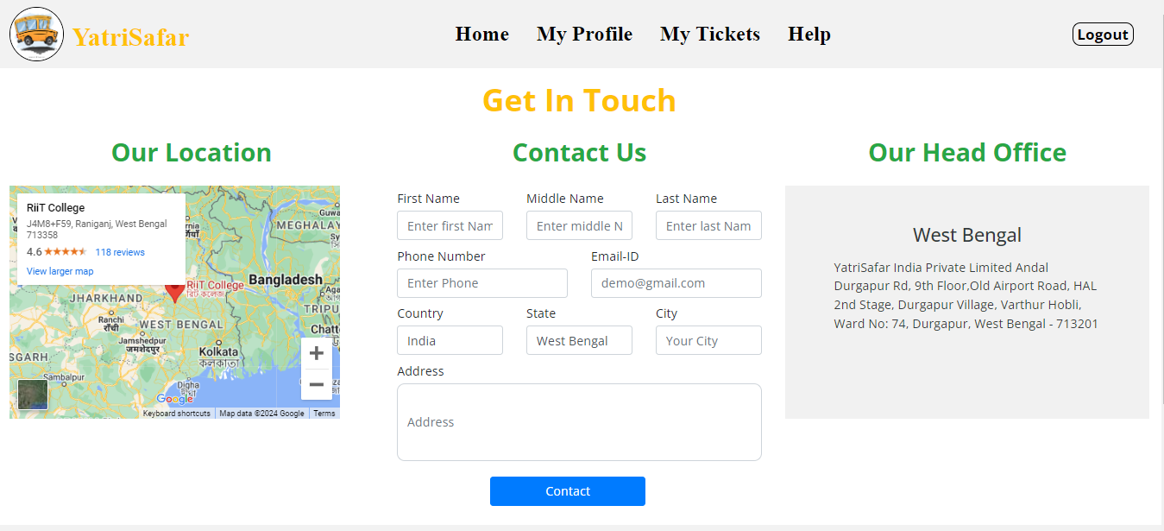
Contact Us

Slide 21
Data Flow Diagram (DFD)
Level 0 DFD For Online Bus Ticket Booking System

Slide 22
Data Flow Diagram (DFD)

Slide 23
ER Diagram

Slide 24
TESTESTING & METHOLOGIES
The project employed various testing methodologies to ensure quality and reliability. Unit testing was used to validate individual components, ensuring they function correctly in isolation. Black box testing verified the system's behavior against specified requirements without examining internal code structure. Integration testing checked the interaction between modules, while regression testing ensured new changes didn't affect existing functionality. Additionally, performance testing assessed the system's responsiveness and stability under load.

Slide 25





Limitation
Absence of payment gateway integration restricts online payment options, potentially inconveniencing users.
Lack of email verification may compromise security and increase the risk of fraudulent bookings.
Inability to choose specific seats diminishes user control and personalization, affecting user experience.
Real-time chat support for assistance is unavailable, reducing accessibility and hindering prompt resolution of user queries.
Limited language support may exclude non-English speaking users, impacting inclusivity and market reach.

Slide 26

Future Scope
Continuous improvement to address existing limitations, including refining payment processes, enhancing verification methods, providing more seat selection options, and optimizing user support features for a seamless booking experience.
Development of a mobile application for on-the-go booking convenience, catering to the increasing trend of mobile usage.
Implementation of analytics and reporting tools to gather insights on user behavior, booking patterns, and popular routes, aiding in decision-making and marketing strategies.
Introduction of a ratings and reviews system for users to share feedback and experiences, fostering transparency and trust within the community.
Expansion of the platform to include additional travel services such as hotel bookings, tour packages, or car rentals, creating a comprehensive travel ecosystem for users.

Slide 27



C o n c l u s i o n
It has been a great pleasure for us to work on this exciting and challenging project. This project proved good for me as it provided practical knowledge with latest technology used in developing web enabled application and client server technology that will be great demand in future. By embracing continuous improvement, we are committed to delivering a comprehensive and accessible solution that caters to diverse user needs and fosters trust in the booking process.

Slide 28


Bib lio g r a p h y
https://www.google.com https://www.w3school.com https://getbootstrap.com https://www.djangoproject.com
https://chat.openai.com

Slide 29




Th a n k You

